Slide 1

Text Mining - INSA
Do It Together
22 Octobre 2018

Slide 2
Sommaire
Presentation
Capgemini Consulting
Assystem technologies
Text Mining
Definition
Preprocessing
DTM
TFIDF
Dimension Reduction
Applications
Topic Modeling
Sentiment Analysis

Slide 3
Sommaire
Presentation
Capgemini Consulting
Assystem technologies
Text Mining
Definition
Preprocessing
DTM
TFIDF
Dimension Reduction
Applications
Topic Modeling
Sentiment Analysis

Slide 4
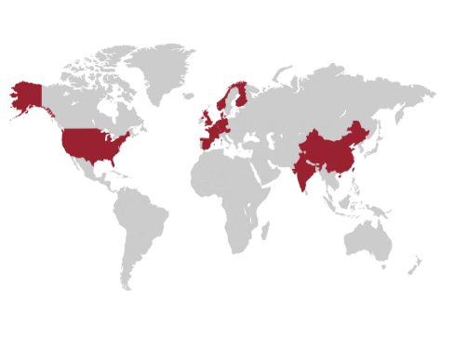






Capgemini Invent, a leader in digital & data transformation
Strategic focus, of our firm since 2012, now standing for 50% of our project portfolio
Leader on the market, with award winning thought leadership, partnership with MIT, and world class recognition
World class footprint, 16 offices, 3,000 consultants, coverage of more than 80% companies of CAC 40 and DAX 30 at CxO level
Acknowledgements of business expertize
Full spectrum digital specialist, Best-of breed provider - 2016
Leader position in the Magic Quadrant for Business Analytics Services 2017
N°1 consultancy for digital, data and transformation - 2016
Top 3 worldwide thought leadership consultancy - 2016

Slide 5














The Insighters, a full-speed capability, focused on building data-driven products & services and transforming organization
Global network, gathering more than 120 data scientists in 6 countries
Project Example : Building a AI platform for the Ministry of the Armed Force
MARIN
Anomaly Detection
and Route Prediction
ECOUTE
Name and Entity Recognition
Network detection
Skills
Data Science
Consulting
Technology
Partners
Big data editors
Specialized players
Agencies
Academic institutions
SAT
Object identification
SECU INFO
Cybersecurity and Attack detection
Asset Library
Gathering of reusable algorithms, data sources, interactive visualization and end to end use case
IT platform
State of the art
That can be made available for projects
PLATFORM
Data
Software
IHM

Slide 6





DATA SCIENCE
About Assystem
Assystem is an international engineering services consulting company.
14 000
employees
50 years
experience
Presence in 20 countries
More than
€900 m
revenue
CONTACT
David RENAUD
drenaud@assystemtechnologies.com
Mob.: +33 6 87 70 86 95
Hugo SECHIER
hsechier@assystemtechnologies.com
Our mission
To enable our customers to embrace the Growth to be
Supporting their product development and investment management throughout the life cycle
Delivering Energy & Infrastructure Engineering and Global Product Solutions
Worldwide
Our added value
A culture of safety
Management of complex projects
The depth of our skills and vertical expertise
Web site: http://www.assystemtechnologies.com/

Slide 7











OUR
REFERENCES
Anomaly detection on Flight Tests
Correlation of parameters on Flight Tests
Scoring of Non Conformance on Supply Chain
Quality Classification with NLP
Search Engine for Non Quality
ChatBot interface for Manufacturing
Classification of delays for railway operation
Identification of influence factors on train delays
Analysis of air conditioning impact on reliability
Failure classification on maintenance report
OCR for REACH Database
Alloy Grains sizes classification based on Computer Vision
Striae detection
Biometric Fraud detection finger print, 3D visage
Face recognition on Social Network
Event detection in Tweets and Web flow
DBA
Reliability Crisis anticipation
Optimisation of Data Cleaning
Operational Reliability Data analysis
Data Visualisation
Reduction of energy consumption
Maintenance preparation
Predictive Maintenance
Notes:
idemia

Slide 8
USE CASE
PRÉSENTATION

Slide 9

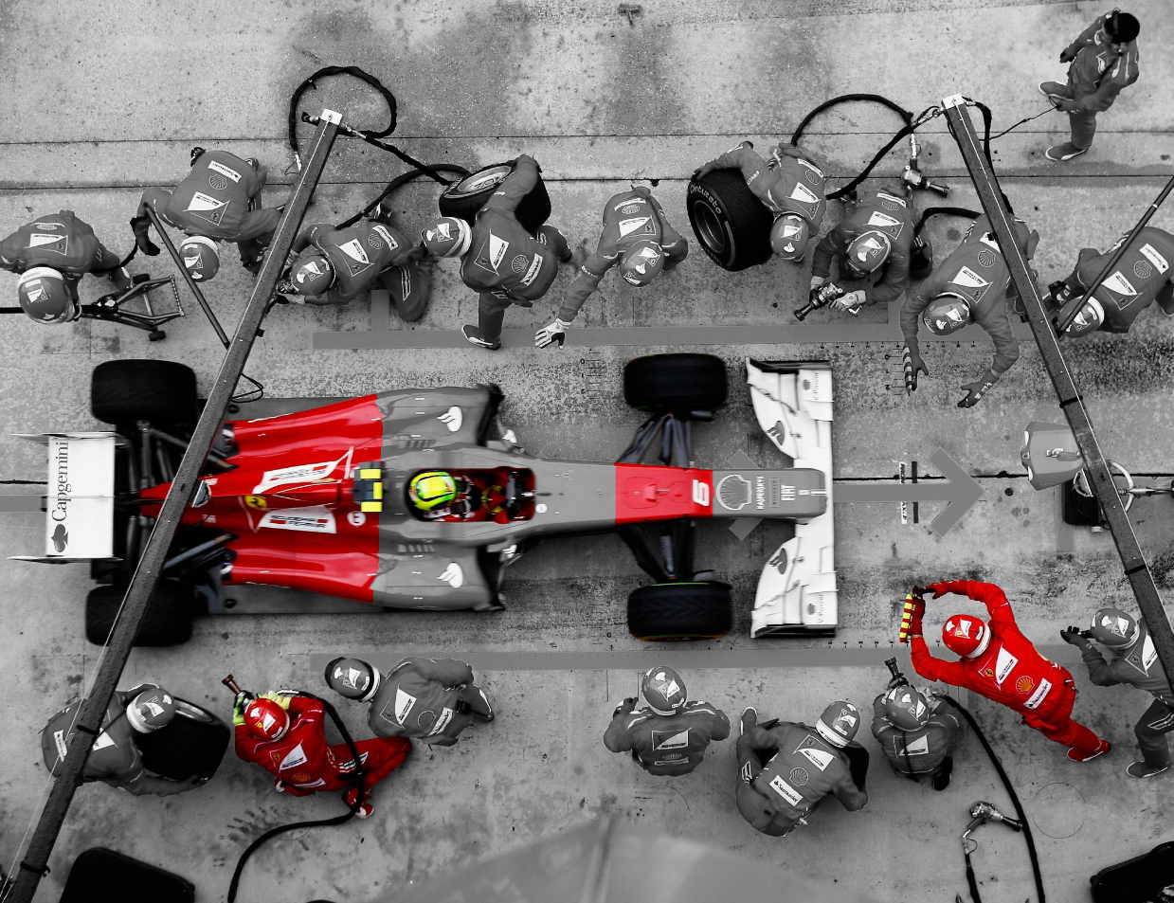

What is a use case?
New Airline Company
Driver Identified end-users
1
Fuel Comprehensive data sources
2
Trip Advisor data sources
5
4
Technical team Advanced analytics capability
3
You
1
3
Motor Robust technical platforms
2
4
Scripts, Open Sources Library
Tires, wheel Digital solutions & touchpoints
5
Dashboarding

Slide 10

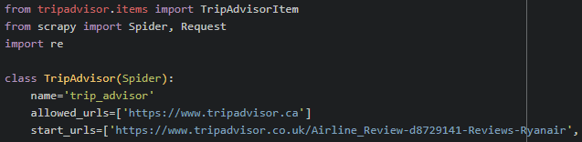
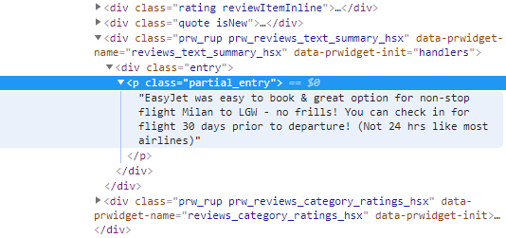
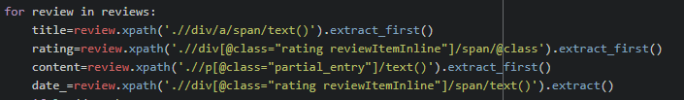
Scraping web pages: Using Scrapy
HTML structure
Scrapy Package on python
HTML is a page containing text arranged into elements, which have attributes
In your command prompt, type:
pip install scrapy
Documentation : https://scrapy.org/
Install package, import scripts
CTRL + MAJ + I
Create the scraping loop for each reviews

Slide 11
Sommaire
Presentation
Capgemini Consulting
Assystem technologies
Text Mining
Definition
Preprocessing
DTM
TFIDF
Dimension Reduction
Applications
Topic Modeling
Sentiment Analysis

Slide 12
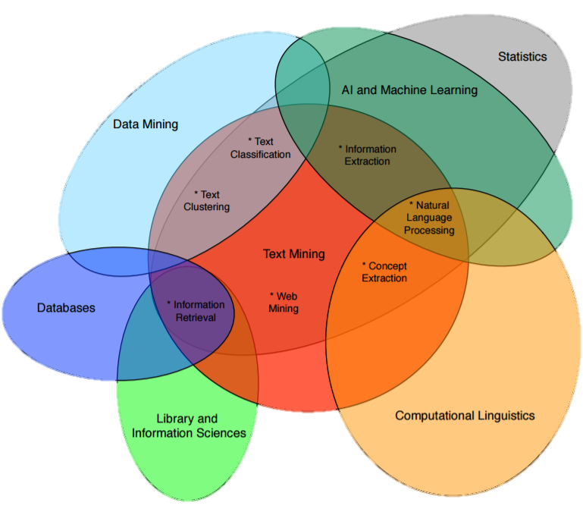
Definition of Text Mining
Text Mining : Process of informations extraction from textual data and usage for multiple objectives.

Slide 13
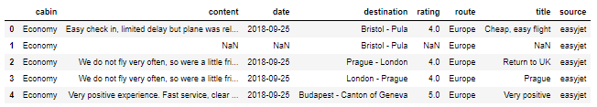
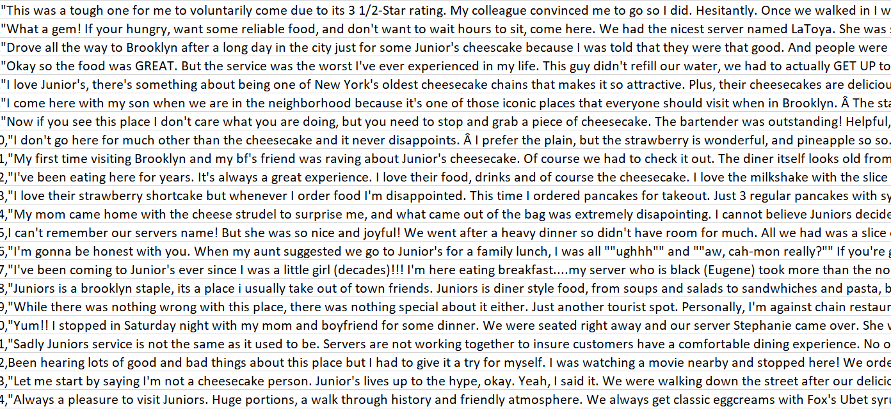
Pre-processing: Introduction
Descriptive Statistics
What processes should we apply on our data before anything to improve the quality of our analysis ?

Slide 14

Préprocessing
Hi, I would like to knnow if you can explain me the famous RF classification algorithm ?
Ponctuation
Hi I would like to knnow if you can explain me the famous RF classification algorithm
Spelling
Hi I would like to know if you can explain me the famous RF classification algorithm
Stop words
Hi I would like to know if you can explain me famous RF classification algorithm
Dictionnary and Lexicon
Hi I would like to know if you can explain me famous Random Forest classification algorithm ?
Stemming & Lemmatisation
Hi I would like to know if you can explain me famous Random Forest classif algorithm ?
2A - 2

Slide 15
Document Term Matrix
t₁ t₂ ∙ ∙ ∙ t_{d}
Document
The Assystem teams are trained to listen, acquire and develop skills, be able to adapt to the inherent challenges of innovation, risk control, complexity, and to convert our customers' goals into the results of our joint projects. With offices in 20 countries, our teams work every day around the world to
The Assystem teams are trained to listen, acquire and develop skills, be able to adapt to the inherent challenges of innovation, risk control, complexity, and to convert our customers' goals into the results of our joint projects. With offices in 20 countries, our teams work every day around the world to
w₁₁ w₁₂ ∙ ∙ ∙ w_{1d}
w₂₁ w₂₂ ∙ ∙ ∙ w_{2d}
∙ ∙ ∙
∙ ∙ ∙
∙ ∙ ∙
w_{t1} w_{t2} ∙ ∙ ∙ w_{td}
Cleaner energy, lighter aircraft, and electric modes of transport for the masses - these are a few of the challenges Assystem's customers face on a daily basis. Our 12.500 employees are committed to addressing these challenges with their know-how, methodologies and conviction.
cycle, coordinating and executing the realization of their projects and infrastructure
Cleaner energy, lighter aircraft, and electric modes of transport for the masses - these are a few of the challenges Assystem's customers face on a daily basis. Our 12.500 employees are committed to addressing these challenges with their know-how, methodologies and conviction.
cycle, coordinating and executing the realization of their projects and infrastructure
Cleaner energy, lighter aircraft, and electric modes of transport for the masses - these are a few of the challenges Assystem's customers face on a daily basis. Our 12.500 employees are committed to addressing these challenges with their know-how, methodologies and conviction.
cycle, coordinating and executing the realization of their projects and infrastructure
d₁
d₂
∙
∙
∙
d_{t}
 | years | Assystem | partner | … | … | …
D1 | 1 | 1 | 1
D2 | 0 | 1 | 0
D3
…
 | years | Assystem | partner
D1 | 1 | 1 | 1
D2
D3
…
 | years | Assystem | partner | … | … | …
D1 | 1 | 1 | 1
D2 | 0 | 1 | 0
D3 | 1 | 2 | 0
…
50 years of experience have made Assystem a key partner of the world's largest industrial groups: Airbus, Areva, Alstom, EDF,... Designing and developing the products and services of tomorrow, building and ensuring the optimum use of their investments throughout the life cycle, coordinating and executing the realization of their projects and infrastructure…
 | years | Assystem | partner | … | … | …
D1
D2
D3
…
50 years of experience have made Assystem a key partner of the world's largest industrial groups: Airbus, Areva, Alstom, EDF,... Designing and developing the products and services of tomorrow, building and ensuring the optimum use of their investments throughout the life cycle, coordinating and executing the realization of their projects and infrastructure…
50 years of experience have made Assystem a key partner of the world's largest industrial groups: Airbus, Areva, Alstom, EDF,... Designing and developing the products and services of tomorrow, building and ensuring the optimum use of their investments throughout the life cycle, coordinating and executing the realization of their projects and infrastructure…

Slide 16
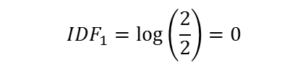
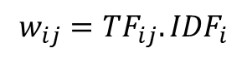
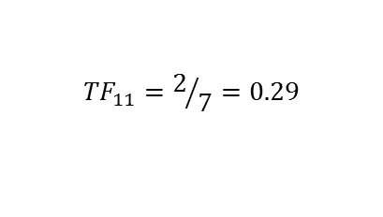
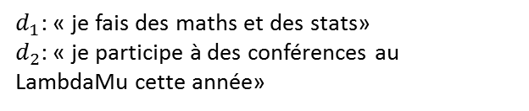
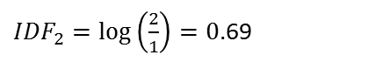
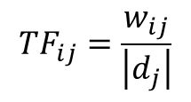
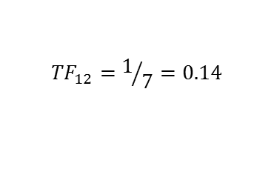
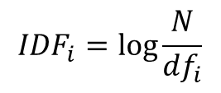
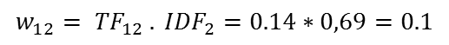
What kind of weight can we use in DTM?
$d_{1}$: « je fais des maths et des stats»
$d_{2}$: « je participe à des conférences au LambdaMu cette année»
Term Frequency (TF)
The more a term appears in a document, the more it contains informations.
des maths
d₁
d₂
w₁₁ w₁₂
w₂₁ w₂₂
$${TF}_{ij}=\frac{w_{ij}}{\left|d_{j}\right|}$$
$${TF}_{12}=1/7=0.14$$
$${TF}_{11}=2/7=0.29$$
Inverse Document Frequency (IDF)
A term that appears in few documents, is a better discriminant than another.
des maths
$${IDF}_{i}=\log{\frac{N}{{df}_{i}}}$$
TF-IDF
Is measuring the importance of a term in a document according to the corpus
$${IDF}_{1}=\log\left(\frac{2}{2}\right)=0$$
${IDF}_{2}=\log\left(\frac{2}{1}\right)=0$.69
d₁
d₂
0 0.1
0 0
$$w_{11}= {TF}_{11} . {IDF}_{1}= 0.29∗0= 0$$
t₁ t₂ ∙ ∙ ∙ t_{d}
$$w_{ij}={TF}_{ij}.{IDF}_{i}$$
$$w_{12}= {TF}_{12} . {IDF}_{2}=0.14∗0,69=0.1$$
d₁
d₂
∙
∙
∙
d_{t}
w₁₁ w₁₂ ∙ ∙ ∙ w_{1d}
w₂₁ w₂₂ ∙ ∙ ∙ w_{2d}
∙ ∙ ∙
∙ ∙ ∙
∙ ∙ ∙
w_{t1} w_{t2} ∙ ∙ ∙ w_{td}
Notes:
Un terme qui apparaît plusieurs fois dans un document est plus important qu’un terme qui n’apparaît qu’une seule fois
Un terme qui apparaît dans peu de documents est un meilleur discriminant qu’un terme qui apparaît dans tous les documents
Mesure l’importance d’un terme dans un document relativement à l’ensemble des documents

Slide 17


Tools for Dimensionality reduction
Feature Selection
Dimension Reduction according to a measurement as frequency of words or TF-IDF
REVIEWS
X = pd.DataFrame(np.random.rand(50,100))
mesure = pd.DataFrame({ "col" : X.columns.values, "imp" : np.random.rand(100) })
col_to_select = measure.sort_values(by= "imp").head(k).col
Xp = X[col_to_select]
X
REVIEWS
Sorted by a measure
X’
WORDS
SELECTED WORDS
REVIEWS
SVD (Singular Value Decomposition)
Matrix Factorization Method
X
U
∑k
Vk
X.svd <- svd(X)
Sig <- diag(r.svd$d)
u <- r.svd$u
v <- r.svd$v
uk <- as.matrix(u[, 1:k])
vk <- as.matrix(v[, 1:k])
Sigk <- as.matrix(d[1:k, 1:k])
Xp <- uk %*% Sigk %*% t(vk )
∑
V
WORDS
≈
Uk
Take only the k first singular values

Slide 18
Tools for Dimensionality reduction
NMF (Non Negative Matrix Factorization)
Unsupervised data decomposition ( for topic learning, feature extraction or clustering)
REVIEWS
TOPICS
REVIEWS
from sklearn.decomposition import NMF
model = NMF(n_components=k, init='random')
W = model.fit_transform(X)
H = model.components_
X
W
H
TOPICS
≈
WORDS
WORDS
library(NMF)
nmf(X,k,"lee") # lee & seung method
from keras.layers import Input, Dense
from keras.models import Model
# Exemple : https://blog.keras.io/building-autoencoders-in-keras.html
Autoencoder
Artificial neural network used for unsupervised learning of efficient codings
REVIEWS
X
X’
WORDS
library(SAENET)
# Exemple : h
https://web.cs.dal.ca/~kallada/stat2450/lectures/Lecture17.pdf
ENCONDER
CODE
DECODER

Slide 19
Sommaire
Presentation
Capgemini Consulting
Assystem technologies
Text Mining
Definition
Preprocessing
DTM
TFIDF
Dimension Reduction
Applications
Topic Modeling
Sentiment Analysis

Slide 20
TOPIC EXTRACTION - LDA

Slide 21
Topics in data
How to define topics?
How to define that a document talks about a topic?
Is a document about one topic only?
Does a new document have new topics?
Can topics summarize documents?

Slide 22
Latent Dirichlet Allocation: an unsupervised algorithm for topic modelling
Automatic topic extraction
"people", "teenagers", "family"
Topic interpretation
Text samples
"Netflix", "TV shows", "season"
"learn", "teaches", "English"
Persons
Document 1
Document 2
TV shows
[...] People spend more time on Netflix than on [...]
[...] Black Mirror is NOT a show for the family [...]
Knowledge
Topic allocation
Document 1
Document 2
Document 3
Document 4
70%
20%
10%
50%
50%
[...] Teenagers watching TV shows learn better English [...]
[...] House of cards teaches the fundamentals of the mechanics of power [...]
Document 3
Document 4
75%
25%
15%
15%
70%
Tasks performed by a LDA model
Notes:
LDA does just that. It allocates words to topics, and topics to documents

Slide 23
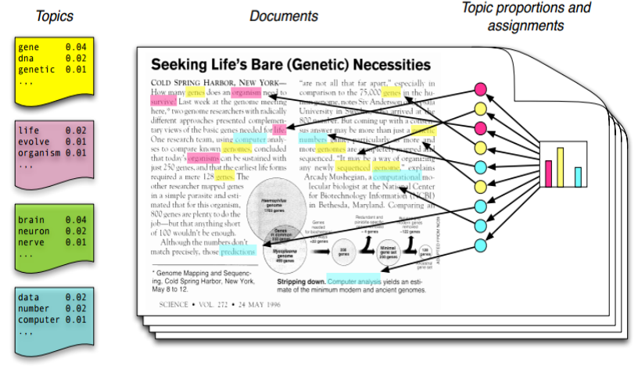
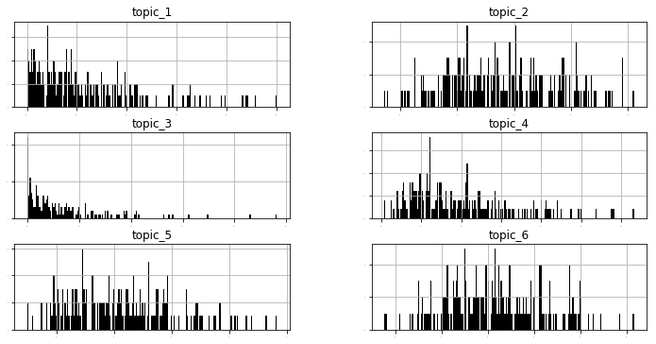
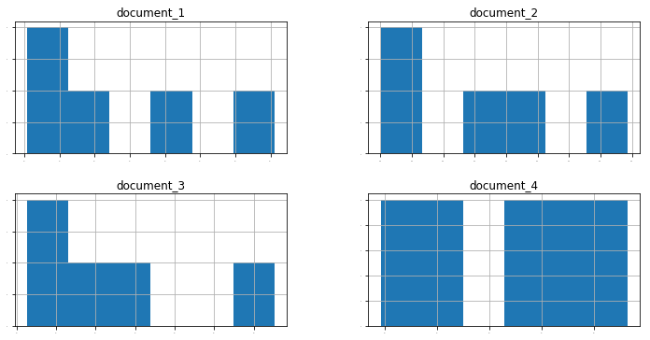
LDA optimizes the probability that documents occur knowing topics are distributed among them
Topics are represented by different word probabilities
Similarly, documents are represented by different topic probabilities

Slide 24



A 3-step approach to succeed in implementing LDA
Test algorithm on a sample of clean data
(optionally) Remove verbs and keep nouns with POS tagging
(optionally) Keep a minimal amount of nouns
Data preparation
Progressions
Fine-tuning model
Number of topics
Alpha & eta for topic & word distributions
Iterations and other parameters
Corrections
Interpretation Validation
Topics interpretation
Unicity and exhaustivity of topics
Topic allocation follows intuition

Slide 25
SENTIMENT ANALYSIS

Slide 26




Sentiment Analysis: Introduction
Goal:
Find the polarity of a text (bad, neutral or good)
Applications:
Recommender system, social media opinion, Customer satisfaction, political opinion, etc..
Challenges:
Irony, complex sentences, domain specific keywords, context
Results:
According to research, human raters agree about 80% of the time, so an accuracy of 80% seems good
2 main approaches
Lexicon based
dictionary with a word and its polarity, some rules are generally added to take into account negation, case, punctuation and other grammatical rules
Machine Learning based
treating the problem as a classification or regression problem, works well with SVMs or NB

Slide 27

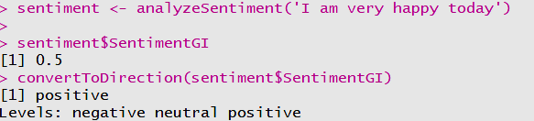

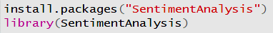
Sentiment Analysis: tools
There are several packages to do sentiment analysis in Python: NLTK, Vader (in NLTK), TextBlob, AFINN etc.
In R, there is the package: SentimentAnalysis
In [1]: from textblob import TextBlob
TextBlob(‘I am very happy today’).sentiment
Out[1]: Sentiment(polarity = 1.0, subjectivity = 1.0)

Slide 28
SCRAPING TOOLS

Slide 29
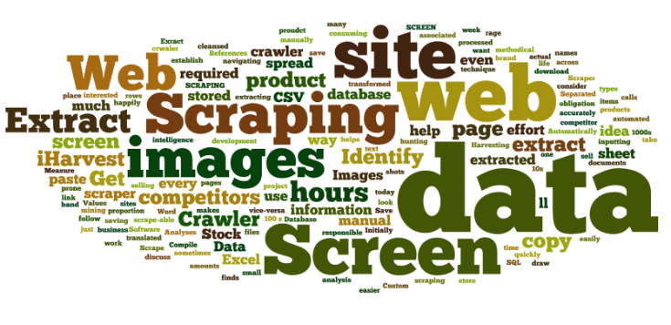






Web scraping: Introduction
Why should we use Web scraping?
No structured Data available
Market Price Analysis (real-time competitiveness)
Market Intelligence
Sentiment Analysis (social reactions)
Which kind of Data are we looking for?
Price / Articles / Reviews
Metadata (number of connections, …)
Find sources we can use (API, Scraping)
What is the typical process?
Standardize dataframe structure
Build a Mapping (Excel, Trello, Turtle)
Ex.: Real-estate market analysis
Note: Trello: https://trello.com/, Turtle: https://turtle.ai/

Slide 30
Scraping web pages: Using Scrapy
HTML structure
Scrapy Package on python
HTML is a page containing text arranged into elements, which have attributes
In your command prompt, type:
pip install scrapy
Documentation : https://scrapy.org/
Install package, import scripts
CTRL + MAJ + I
Create the scraping loop for each reviews

Slide 31

To go further…
Feature Engineering and Selection CS 294: Practical Machine Learning. October 1st, 2009. Alexandre Bouchard-Côté https://people.eecs.berkeley.edu/~jordan/courses/294-fall09/lectures/feature/slides.pdf
Stemming and lemmatization An Introduction to Information Retrieval, 2009. Christopher D. Manning, Prabhakar Raghavan & Hinrich Schütze
http://nlp.stanford.edu/IR-book/html/htmledition/stemming-and-lemmatization-1.html

Slide 32
Graph of words
(graph of word : https://safetyapp.shinyapps.io/GoWvis/, word2vec : http://bionlp-www.utu.fi/wv_demo/ ou http://turbomaze.github.io/word2vecjson/, …)

